Slide 1

talking about roles
an example
June 2024 | version one | doing research together

Slide 2
overview
not knowing what roles are available can stop people with lived experience from asking or making suggestions. diagrams and examples can make roles clearer.
why we made this
Without research experience, it’s
hard to know what roles are available.
Power differences can stop people
with lived experience from asking
for what they want out of fear of the
role not being available or being
told they don’t have the right skills.
Be transparent about roles and
responsibilities from the beginning.
what’s in this document
We show an example of how you might use a diagram to show the roles available in your project for people with lived experience. You might use a visual in planning sessions and in one-to-one conversations. We give some overall tips on planning for roles on page 6.
Unsure about which roles your project could include? Ask colleagues who have co-designed or co-delivered research.
how to use our example (pages 4–5)
Use our example as inspiration to consider and communicate roles. Our example isn’t the only way, and we give other ideas on page 3. For each role, think about key tasks, time commitment and the support available.
You can edit this document and make it your own version by adding, changing or deleting roles.
The diagrams on pages 4 & 5 are based on a visual created by KA McKercher as part of the co-planning process for a successful MRFF grant focused on better health outcomes with and for trans young people. Cite this as: McKercher, KA & NSW Regional Health Partners. (2024). Talking about roles: an example. Version One.
talking about roles
nsw regional health partners | doing research together

Slide 3
there are many different roles in research projects
Some roles require a lot of time, are on-going and have many legal and ethical responsibilities, while other roles might be less time-consuming
with fewer responsibilities.
On pages 4 & 5 we give an example of roles and tasks.
Our example isn’t the only way.
There are other ways you might identify and show roles –
for example, you might:
plot roles across the research cycle
(see one-page example from Young and Resilient Research Centre
on roles for co-researchers across the research cycle)
create an organisational chart or team chart
remember,
being a consumer, or health worker isn’t a specific research role –
talk about tasks and responsibilities

Slide 4
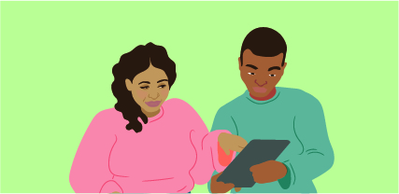

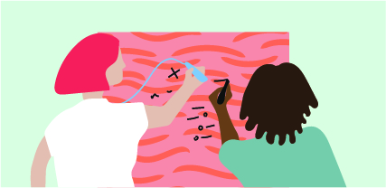

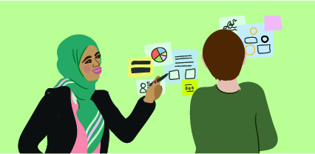
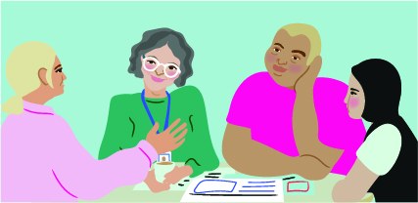
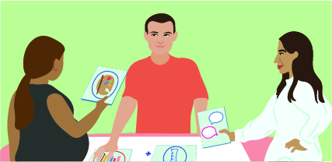
more detail
example: lived experience tasks and roles
what to do: add or remove roles in your project – stay open to suggestions of other roles
on-going | when needed |  |  | employment for part/all of the project |  |  | add your own
be on the advisory group | talk with media or government | do artwork, help design or write | help to share the research findings | be a research assistant | be a peer [researcher/ facilitator/ debriefer] | be part of the team leading the research
come to meetings give your advice review things learn how to co-chair meetings (if you’d like to) | advocate for practice, policy or funding change share stories to help make change get support on what to share, how to share it and how to look after yourself | make recruitment materials make things for programs (e.g. workbooks, pamphlets, websites) help with publications create artwork or images to communicate the research | help to write things (publications) help to share findings in different ways (e.g. design and run events, webinars, videos, pamphlets, website) | find people to do research with create recruitment materials help with research activities, analysis, synthesis and sharing the findings | lead research activities with other people with lived experience run specific programs for [x] support other people with lived experience in the project | work with others to lead the research from start to finish be responsible for the quality and ethical-integrity of the research make sure [x] people are involved across everything
time commitment (roughly)
⏱️ | ⏱️ | ⏱️ | ⏱️ | ⏱️⏱️⏱️ | ⏱️⏱️⏱️⏱️ | ⏱️⏱️⏱️⏱️⏱️
across all roles: ensure recognition, learn, be supported and connect with others trying to make change
talking about roles
nsw regional health partners | doing research together

Slide 5
less detail
example: lived experience tasks and roles
what to do: add or remove roles in your project – stay open to suggestions of other roles
on-going | when needed |  |  | employment for part/all of the project* |  |  | add your own
be on the advisory group | talk with media or government | do artwork, help design or write | help to share the research findings | be a research assistant | be a peer [researcher/ facilitator/ debriefer] | be part of the team leading the research
time commitment (roughly)
⏱️ | ⏱️ | ⏱️ | ⏱️ | ⏱️⏱️⏱️ | ⏱️⏱️⏱️⏱️ | ⏱️⏱️⏱️⏱️⏱️
across all roles: ensure recognition, learn, be supported and connect with others trying to make change
*We use the term ‘employment’ when thinking about roles once the project is funded. People might not be employed in the planning phase but plan to be if the project is funded.
talking about roles
nsw regional health partners | doing research together

Slide 6
tips and reminders
planning for roles
here are six tips when planning, recruiting for, setting and checking on roles
Talk about roles early and often. Don’t assume everyone understands what roles are available or what their role is. Don’t assume what roles other’s want to play. Stay curious. People can grow into roles even if they haven’t done the role before.
Consider if people can do multiple roles (e.g. it may not be possible to be on advisory group and be part of the team). Be clear about legal, financial and ethical responsibilities for different roles.
Ensure recognition for lived experience roles. Read more.
Consider how you’ll make role recruitment a fair and
transparent process.
Stay curious about how the roles need to be supported or redesigned to be more accessible to people with lived experience. For example, a job-share, flexibility with hours or something else.
If you are engaging community members ad-hoc (for example, as spokespeople to the media) remember to extend them the same care as you would a member of your team. Check-in on them.
remember - even in a co-design project, some people’s involvement might be consultation
talking about roles
nsw regional health partners | doing research together

